Slide 1

Chapter 1: Introduction

Slide 2
Requirements for this Class
You are proficient in a programming language, but you have no experience in analysis or design of a system
You want to learn more about the technical aspects of analysis and design of complex software systems

Slide 3
Objectives of the Class
Appreciate Software Engineering:
  Build complex software systems in the context of frequent change
Understand how to
  produce a high quality software system within time
  while dealing with complexity and change
Acquire technical knowledge (main emphasis)
Acquire managerial knowledge

Slide 4
Acquire Technical Knowledge
Understand System Modeling
Learn UML (Unified Modeling Language)
Learn different modeling methods:
    Use Case modeling
    Object Modeling
    Dynamic Modeling
    Issue Modeling
Learn how to use Tools:
  CASE (Computer Aided Software Engineering)
    Tool: Together-J
Component-Based Software Engineering
  Learn how to use Design Patterns and Frameworks

Slide 5
Acquire Managerial Knowledge
Understand the Software Lifecycle
  Process vs Product
  Learn about different software lifecycles
  Greenfield Engineering, Interface Engineering, Reengineering

Slide 6
Readings
Required:
  Bernd Bruegge, Allen Dutoit: “Object-Oriented Software Engineering: Using UML, Patterns, and Java”, Prentice Hall, 2003.
Recommended:
  I. Sommerville. Software Engineering. Prentice Hall
  UML e Unified Process. Analisi e Progettazione Object Oriented. J. Arlow e I. Neustadt. McGraw-Hill
  J. Rumbaugh,I. Jacobson, G. Booch. The Unified Modeling Languge Reference Manual. Addison Wesley
  (Per studenti v.o.) A. Guidi, D. Bordolò. Guida a SQL. Apogeo

Slide 7
Outline of Today’s Lecture
High quality software: State of the art
Modeling complex systems
  Functional vs. object-oriented decomposition
Dealing with change:
  Software lifecycle modeling
Concluding remarks

Slide 8
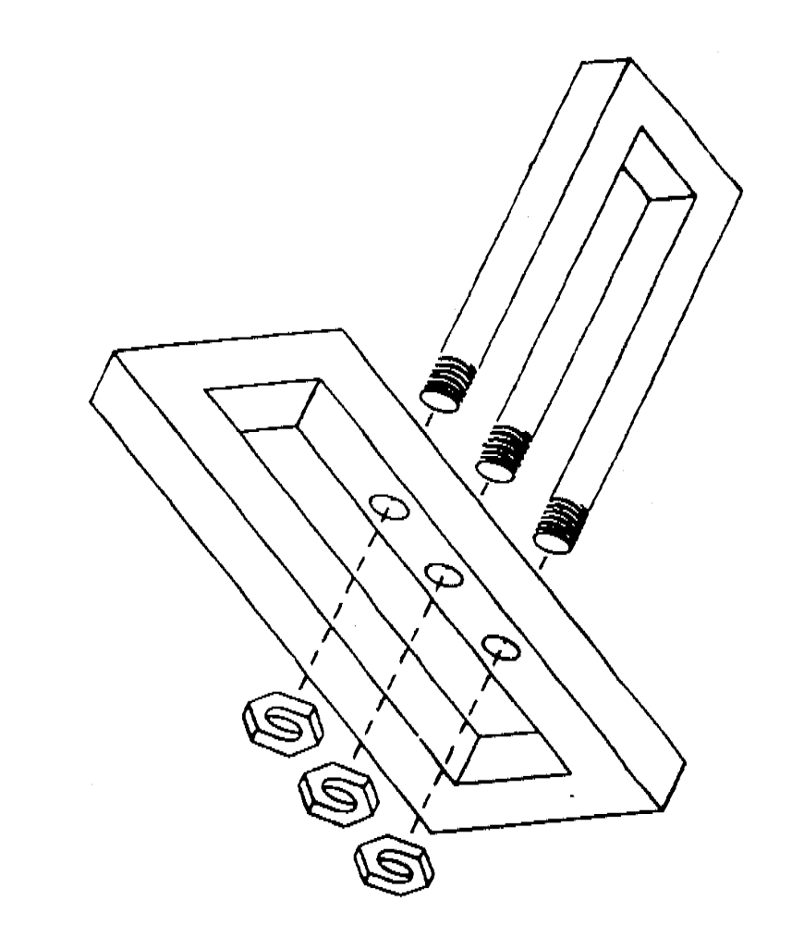
Can you develop this?
Notes:
The answer to the question “Can we develop this” depends on what we mean by developing.
Let us assume, that we mean by “development” that it that it eventually can be used by an end user.
Can we develop this? No, if we ask an artist, he will say, yes. Because in this case the end user might be a connesseur of art, who puts a drawing of this on the wall in her living room.
There are a variety of famous artists who made their fortune with these types of drawing (Escher, Dali).
So, defining it to be “useful for an end user” is not enough.

Slide 9
Limitations of Non-engineered Software
Requirements
Here is the problem!!
Software
Notes:
One of the problems with complex system design is that you cannot foresee the requirements at the beginning of the project. In many cases, where you think you can start with a set of requirements, that specifies the completely the properties of your system you end up with....

Slide 10
Software Production has a Poor Track Record
Example: Space Shuttle Software
Cost: $10 Billion, millions of dollars more than planned
Time: 3 years late
Quality: First launch of Columbia was cancelled because of a synchronization problem with the Shuttle's 5 onboard computers.
  Error was traced back to a change made 2 years earlier when a programmer changed a delay factor in an interrupt handler from 50 to 80 milliseconds.
  The likelihood of the error was small enough, that the error caused no harm during thousands of hours of testing.
Substantial errors still exist.
  Astronauts are supplied with a book of known software problems "Program Notes and Waivers".

Slide 11
Software Engineering: A Problem Solving Activity
Analysis: Understand the nature of the problem and break the problem into pieces
Synthesis: Put the pieces together into a large structure
For problem solving we use
Techniques (methods):
  Formal procedures for producing results using some well-defined notation
Methodologies:
  Collection of techniques applied across software development and unified by a philosophical approach
Tools:
  Instrument or automated systems to accomplish a technique
Notes:
What is Software Engineering? The goal is to produce high quality software to satisfy a set of functional and nonfunctional requirements. How do we do that?
First, and foremost, by acknowledging that it is a problem solving activity. That is, it has to rely on well known techniques that are used all over the world for solving problems. There are two major parts of any problem solving process:
Analysis: Understand the nature of the problem. This is done by looking at the problem and trying to see if there are subaspects that can be solved independently from each other. This means, that we need to identify the pieces of the puzzle (In object-oriented development, we will call this object identification).
Synthesis: Once you have identified the pieces, you want to put them back together into a larger structure, usually by keeping some type of structure within the structure.
Techniques, Methodologies and Tools: To aid you in the analysis and synthesis you are using 3 types of weapons: Techniques are well known procedures that you know will produce a result (Algorithms, cook book recipes are examples of techniques). Some people use the word “method” instead of technique, but this word is already reserved in our object-oriented development language, so we won’t use it here. A collection of techniques is called a methodology. (A cookbook is a methodology). A Tool is an instrument that helps you to accomplish a method. Examples of tools are: Pans, pots and stove. Note that these weapons are not enough to make a really good sauce. That is only possible if you are a good cook. In our case, if you are a good software engineer. Techniques, methodologies and tools are the domain of discourse for computer scientists as well. What is the difference?

Slide 12
Software Engineering: Definition
Software Engineering is a collection of techniques,
methodologies and tools that help with the production of
a high quality software system
with a given budget
before a given deadline
while change occurs.
20

Slide 13
Scientist vs Engineer
Computer Scientist
  Proves theorems about algorithms, designs languages, defines knowledge representation schemes
  Has infinite time…
Engineer
  Develops a solution for an application-specific problem for a client
  Uses computers & languages, tools, techniques and methods
  Has finite (usually enough) time…
Software Engineer
  Works in multiple application domains
  Has only 3 months...
  …while changes occurs in requirements and available technology
Notes:
A computer scientist assumes that techniques, methodologies and tools are to be developed. They investigate in designs for each of these weapons, and prove theorems that specify they do what they are intended to do. They also design languages that allow us to express techniques. To do all this, a computer scientist has available an infinite amount of time.
A software engineering views these issues as solved. The only question for the software engineer is how these tools, techniques and methodologies can be used to solve the problem at hand. What they have to worry about is how to do it under the time pressure of a deadline. In addition they have to worry about a budget that might constrain the solution, and often, the use of tools. Good software engineering tools can cost up to a couple of $10,000 Dollars (Galaxy, Oracle 7, StP/OMT)
Object modeling is difficult. As we will see, good object modeling involves mastering complex concepts, terminology and conventions. It also requires considerable and sometimes subjective expertise in a strongly experience-based process. Beware of the false belief that technology can substitute for skill, and that skill is a replacement for thinking. offers this advise [cit Tillmann].
Many organizations are frustrated with a lack of quality from their tool-based systems. However, the cause of this problem is often the false belief that a tool can be a substitute for knowledge and experience in understanding and using development techniques. Although CASE tools such as StP/OMT or Objectory and similar tools have the potential to change how people design applications, it is a mistake to think they can replace the skills needed to understand and apply underlying techniques such as object, functional or dynamic modeling. You cannot substitute hardware and software for grayware (brain power) [cit Tillmann]: Buying a tool does not make a poor object modeler a good object modeler. Designers need just as much skill in applying techniques with CASE tools as they did with pen and paper.
Another problem, that is often associated with tool-based analysis is that it is often insufficient or incomplete. Why is that? To a certain extent this problem has always existed. Systems developers are much better at collecting and documenting data than they are at interpreting what these data mean. This in unfortunate, because the major contribution an analysist can bring to system development is the thought process itself. But just as a tool is not a substitute for technique, knowledge and experience, technique skills cannot replace good analysis - people are still needed to think through the problem.
So our message is: Being able to use a tool does not mean you understand the underlying techniques, and understanding the techniques does not mean you understand the problem. In the final analysis, organizations and practitioners must recognize, that methodologies, tools and techniques do not represent the added values of the object modeling process. Rather, the real value that is added, is the thought and insight that only the analyst can provide.

Slide 14
Factors affecting the quality of a software system
Complexity:
  The system is so complex that no single programmer can understand it anymore
  The introduction of one bug fix causes another bug
Change:
  The “Entropy” of a software system increases with each change: Each implemented change erodes the structure of the system which makes the next change even more expensive (“Second Law of Software Dynamics”).
  As time goes on, the cost to implement a change will be too high, and the system will then be unable to support its intended task. This is true of all systems, independent of their application domain or technological base.

Slide 15
Why are software systems so complex?
The problem domain is difficult
The development process is very difficult to manage
Software offers extreme flexibility
Software is a discrete system
  Continuous systems have no hidden surprises (Parnas)
  Discrete systems have!
Notes:
The problem domain is sometimes difficult, just because we are not experts in it. That is, it might not be intellectually challenging, but because you are not an expert in it, you have to learn it. Couple this with learning several problem domains, and that is what you will have to do as a software engineer, and the problem becomes obvious.
The development process is very difficult to manage. This has taken some time and some billion dollars to learn, but we are now starting to accept the fact, that software development is a complex activity. One of the assumptions that managers have made in the past, is that software development can be managed as a set of steps in linear fashion, for example: Requirements Specification, followed by System Design followed by Implementation followed by Testing and Delivery.
In reality this is not that easy. Software Development does not follow a linear process. It is highly nonlinear. There are dependencies between the way you design a system and the functionality you require it to have. Moreover, and that makes it really tricky, some of these dependencies cannot be formulated unless you try the design.
Another issue: Software is extremely flexible. We can change almost anything that we have designed in software. While it is hard to change the layout of a washing machine, it is extremely easy to change the program running it.
Here is another problem: When you are sitting in a plane in a window seat, and you push a button to call the steward for a drink, you don’t expect the system to take a hard left turn and dive down into the pacific. This can happen with digital systems. One of the reasons: While you can decompose the system into subsystems, say “Call Steward” and “Flight Control” subsystems, if you don’t follow good design rules, you might have used some global variable for each of these subsystems. And one of these variables used by the flight control subsystem might have been overwritten by the Call Steward SubSystem.

Slide 16
Dealing with Complexity
Abstraction
Decomposition
Hierarchy
Notes:
Hierarchy (Booch 17):
Object model is called object structure
by Booch

Slide 17
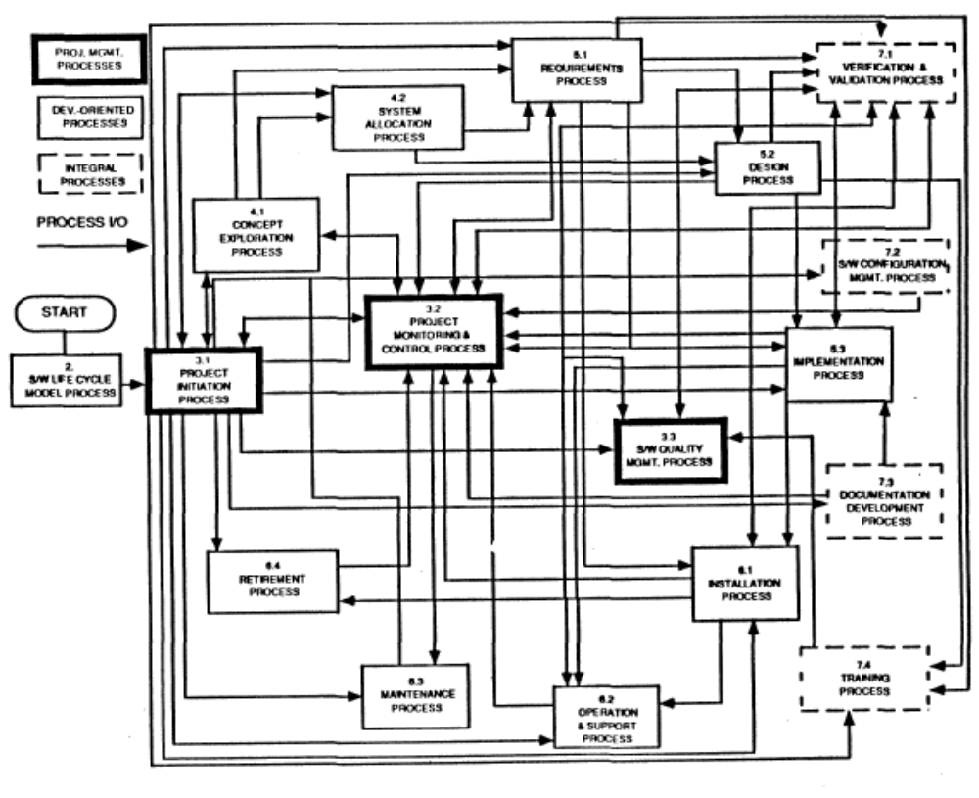
What is this?

Slide 18
1. Abstraction
Inherent human limitation to deal with complexity
  The 7 +- 2 phenomena
Chunking: Group collection of objects
Ignore unessential details: => Models

Slide 19
Models are used to provide abstractions
System Model:
  Object Model: What is the structure of the system? What are the objects and how are they related?
  Functional model: What are the functions of the system? How is data flowing through the system?
  Dynamic model: How does the system react to external events? How is the event flow in the system ?
Task Model:
  PERT Chart: What are the dependencies between the tasks?
  Schedule: How can this be done within the time limit?
  Org Chart: What are the roles in the project or organization?
Issues Model:
  What are the open and closed issues? What constraints were posed by the client? What resolutions were made?

Slide 20
Interdependencies of the Models
System Model (Structure,
Functionality,
Dynamic Behavior)
Issue Model
(Proposals,
Arguments,
Resolutions)
Task Model
(Organization,
Activities
Schedule)

Slide 21
The “Bermuda Triangle” of Modeling
System Models
Object Model
Forward
Engineering
Reverse
Engineering
class...
class...
class...
Code
Functional
Model
Dynamic Model
Constraints
Arguments
Org Chart
Issues
Pro Con
PERT Chart
Proposals
Gantt Chart
Issue Model
Task Models

Slide 22
Model-based software Engineering:
Code is a derivation of object model
Pr
oblem Statement
:
A
stock exchange lists many companies.
Each company is identified by a ticker symbol
Analysis phase results in cbject model (UML Class Diagram):
*
*
Company
StockExchange
Lists
tickerSymbol
Implementation phase results in code
public class StockExchange
{
public Vector m_Company = new Vector();
};
public class Company
{
public int m_tickerSymbol
public Vector m_StockExchange = new Vector();
};
A good software engineer writes as little code as possible

Slide 23
Example of an Issue: Galileo vs the Church
What is the center of the Universe?
  Church: The earth is the center of the universe. Why? Aristotle says so.
  Galileo: The sun is the center of the universe. Why? Copernicus says so. Also, the Jupiter’s moons rotate round Jupiter, not around Earth.

Slide 24
Issue-Modeling
Issue:
What is the
Center of the
Universe?
Resolution (1998):
The church declares
proposal 1 was wrong
Resolution (1615):
The church
decides proposal 1
is right
Proposal1:
The earth!
Proposal2:
The sun!
Pro:
Aristotle
says so.
Pro:
Copernicus
says so.
Con:
Jupiter’s moons rotate
around Jupiter, not
around Earth.
Pro:
Change will disturb
the people.

Slide 25
2. Decomposition
A technique used to master complexity (“divide and conquer”)
Functional decomposition
  The system is decomposed into modules
  Each module is a major processing step (function) in the application domain
  Modules can be decomposed into smaller modules
Object-oriented decomposition
  The system is decomposed into classes (“objects”)
  Each class is a major abstraction in the application domain
  Classes can be decomposed into smaller classes
Which decomposition is the right one?
Notes:
Which decomposition is the right one? If you think you are politically correct, you probably want to answer: Object-oriented. But that is actually wrong. Both views are important
Functional decomposition emphasises the ordering of operations, very useful at requirements engineering stage and high level description of the system.
Object-oriented decomposition emphasizes the agents that cause the operations. Very useful after initial functional description. Helps to deal with change (usually object don’t change often, but the functions attached to them do).

Slide 26
Functional Decomposition
System
Function
Top Level functions
Read Input
Transform
Produce
Output
Level 1 functions
Read Input
Transform
Produce
Output
Level 2 functions
Load R10
Add R1, R10
Machine Instructions

Slide 27
Functional Decomposition
Functionality is spread all over the system
Maintainer must understand the whole system to make a single change to the system
Consequence:
  Codes are hard to understand
  Code that is complex and impossible to maintain
  User interface is often awkward and non-intuitive
Example: Microsoft Powerpoint’s Autoshapes
(see next page)

Slide 28
Functional Decomposition: Autoshape
Autoshape
Change
Draw
Mouse
click
Change
Rectangle
Change
Oval
Change
Circle
Draw
Rectangle
Draw
Oval
Draw
Circle

Slide 29
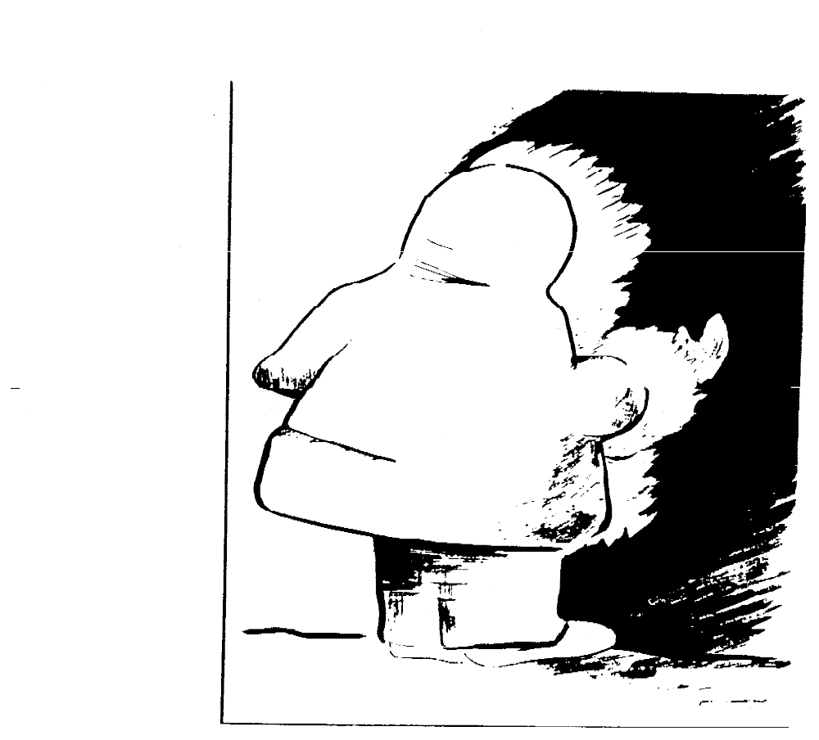
What is This?
Notes:
Object Technology does not make a team perform better or worse, it merely given a team a new excuse not to do so (Racco).
What is the problem? OO Technology has been around with us now for 25 years, and has accelerated enormously in the last 10 years.
By some people it has been hailed as the final solution to all our software engineering problems. By others it has been hailed as the final nail in the coffin that prevents us from thinking.
There are instances in industry, where teams very disciplined in object technology failed to deliver systems that met requirements or management goals. In other cases, teams excelled. What was the difference?

Slide 30
Model of an Eskimo
Eskimo
Size
Dress()
Smile()
Sleep()
*
Shoe
Size
Color
Type
Wear()
Coat
Size
Color
Type
Wear()
Notes:
Because of the ambiguity of the picture we can model it in several ways:
> As a bitmap of black and white pixels
> As an eskimo entering a cave
> As the portraint of an Indian with closed eyes
Which one is the correct model? We don’t know as long as we don’t know the application domain. Here is an important example where we should consult application domain experts and end users.
However, even the expert should not be relied on being able to explain to you all the objects of the application domain. User-centered analysis means that we interactively (in a dialectic way) explore the objects of the application domain.
A good way to approach this discussion is to start with one or more object models as hypotheses. (It is important here to stress the fact that they are hypotheses, that are to be improved (by enhancements or starting from scratch) in an incremental and iterative (dialective) way.
For example, in the above case, the object modeler might prepare two object models: That there is a face (we don’t see it in the picture), that the face has two ears and a mouth
Note: Sometimes the application domain is obvious and one could argue that it is not necessary to create more than one object model. However, presenting the two or three possible object models has an important advantage: It might show the involved parties (developers, application domain expert and end user) that the application domain has ambigious objects. For that reason it is also important not to go into too much depth in the formulation of the first object model version. The above object models might be enough to disambiguate the problem statement. If it is decided that the picture actually presents an eskimo that more in depth object modeling is appropriate.

Slide 31
Iterative Modeling then leads to ....
Eskimo
Size
Dress()
Smile()
Sleep()
lives in
Outside
Temperature
Light
Season
Hunt()
Organize()
moves
around
Cave
Lighting
Enter()
Leave()
*
Entrance
Windhole
Diameter
MainEntrance
Size
but is it the right model?
Notes:
At this stage of the analysis we concentrate on the living conditions for the eskimo. In particular, the attribute entrance turns out to be very important, because the Cave has more than one entrance each of them with different dynamic behavior. During a blizzard, the cave is entered only through one of the wind holes which are not in the direction the wind is blowing, whereas during calm periods the Cave is entered during the MainEntrance. The shape of the windhole is a circle, whereas the MainEntrance is a rectangle. Note that due to the inheritance we do not model that there are many Windholes and only one MainEntrance. According to the object model shown, there can be many MainEntrances as well.
We also start modeling the Outside, where the Temparature, the Light and the Season are important attributes which determine whether the Eskimo is hunting or getting some order in the cave.

Slide 32
Alternative Model: The Head of an Indian
Indian
Hair
Dress()
Smile()
Sleep()
Face
Nose
smile()
close_eye()
Mouth
NrOfTeeths
Size
open()
speak()
Ear
Size
listen()
*
Notes:
In this object model we have decided to model an indian head. We now consider the mouth and the ears to be important objects with their own dynamic behavior instead of just being static attributes of a face and that the person does most of the work with his ears and mouth where the size are important. This means that we create two more objects, Ear and Mouth. Theses classes are created by removing the attributes from the Face class in the previous picture and making them parts of the Face class by connecting them with aggregate associations. The model also contains 2 hypotheses: That the face has two ears and one mouth. This knowledge comes from our general knowledge, not from the application domain, and it is therefore important to verify this fact.
2

Slide 33
Class Identification
Class identification is crucial to object-oriented modeling
Basic assumption:
  We can find the classes for a new software system: We call this Greenfield Engineering
  We can identify the classes in an existing system: We call this Reengineering
  We can create a class-based interface to any system: We call this Interface Engineering
Why can we do this? Philosophy, science, experimental evidence
What are the limitations? Depending on the purpose of the system different objects might be found
  How can we identify the purpose of a system?

Slide 34
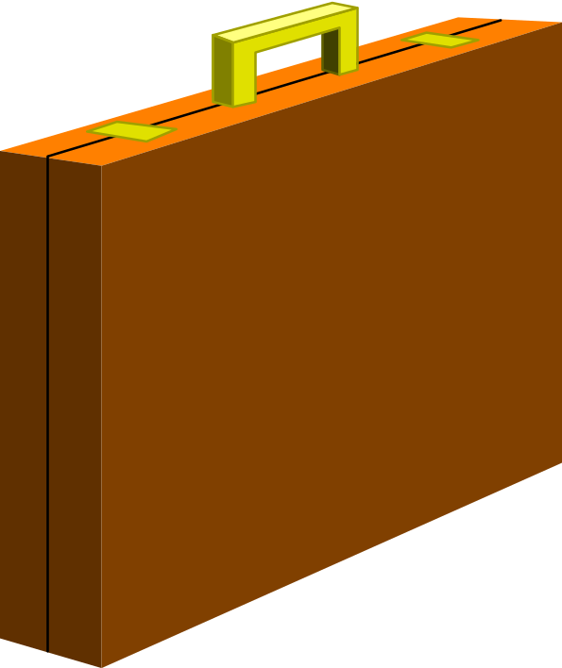
What is this Thing?

Slide 35
Modeling a Briefcase
BriefCase
Capacity: Integer
Weight: Integer
Open()
Close()
Carry()

Slide 36
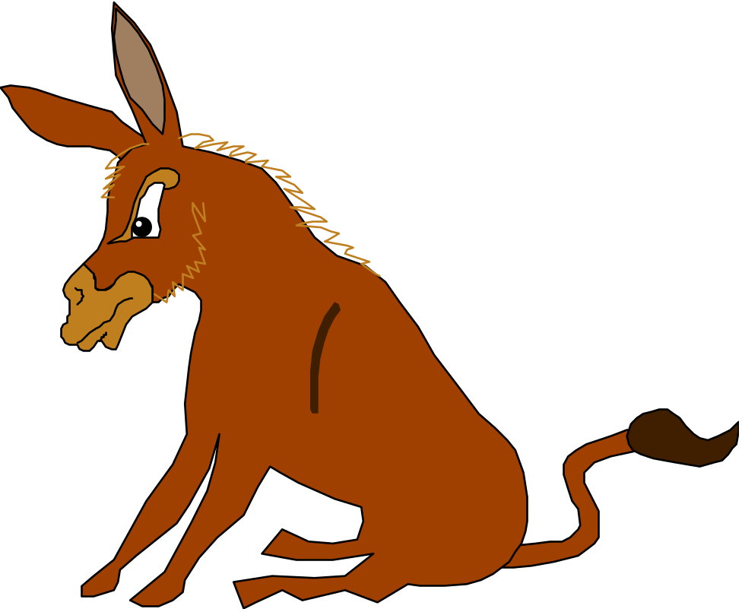
A new Use for a Briefcase
BriefCase
Capacity: Integer
Weight: Integer
Open()
Close()
Carry()
SitOnIt()

Slide 37
Questions
Why did we model the thing as “Briefcase”?
Why did we not model it as a chair?
What do we do if the SitOnIt() operation is the most frequently used operation?
The briefcase is only used for sitting on it. It is never opened nor closed.
  Is it a “Chair”or a “Briefcase”?
How long shall we live with our modeling mistake?

Slide 38
3. Hierarchy
We got abstractions and decomposition
  This leads us to chunks (classes, objects) which we view with object model
Another way to deal with complexity is to provide simple relationships between the chunks
One of the most important relationships is hierarchy
2 important hierarchies
  "Part of" hierarchy
  "Is-kind-of" hierarchy

Slide 39
Part of Hierarchy
Computer
I/O Devices
CPU
Memory
Cache
ALU
Program
Counter

Slide 40
Is-Kind-of Hierarchy (Taxonomy)
Cell
Muscle Cell
Blood Cell
Nerve Cell
Striate
Smooth
Red
White
Cortical
Pyramidal

Slide 41
So where are we right now?
Three ways to deal with complexity:
  Abstraction
  Decomposition
  Hierarchy
Object-oriented decomposition is a good methodology
  Unfortunately, depending on the purpose of the system, different objects can be found
How can we do it right?
  Many different possibilities
  Our current approach: Start with a description of the functionality (Use case model), then proceed to the object model
  This leads us to the software lifecycle
Notes:
The identification of objects and the definition of the system boundary are heavily intertwined with each other.

Slide 42
Software Lifecycle Activities
...and their models
Requirements
Elicitation
Analysis
System
Design
Object
Design
Implemen-
tation
Testing
Implemented
By
Expressed in Terms Of
Structured By
Realized By
Verified
By
class...
class...
class...
?
class....
?
Use Case
Model
Application
Domain
Objects
Solution Domain
Objects
Subsystems
Source
Code
Test
Cases

Slide 43
Software Lifecycle Definition
Software lifecycle:
  Set of activities and their relationships to each other to support the development of a software system
Typical Lifecycle questions:
  Which activities should I select for the software project?
  What are the dependencies between activities?
  How should I schedule the activities?

Slide 44
Reusability
A good software design solves a specific problem but is general enough to address future problems (for example, changing requirements)
Experts do not solve every problem from first principles
  They reuse solutions that have worked for them in the past
Goal for the software engineer:
  Design the software to be reusable across application domains and designs
How?
  Use design patterns and frameworks whenever possible

Slide 45
Design Patterns and Frameworks
Design Pattern:
  A small set of classes that provide a template solution to a recurring design problem
  Reusable design knowledge on a higher level than datastructures (link lists, binary trees, etc)
Framework:
  A moderately large set of classes that collaborate to carry out a set of responsibilities in an application domain.
    Examples: User Interface Builder
Provide architectural guidance during the design phase
Provide a foundation for software components industry

Slide 46
Patterns are used by many people
Chess Master:
  Openings
  Middle games
  End games
Writer
  Tragically Flawed Hero (Macbeth, Hamlet)
  Romantic Novel
  User Manual
Architect
  Office Building
  Commercial Building
  Private Home
Software Engineer
  Composite Pattern: A collection of objects needs to be treated like a single object
  Adapter Pattern (Wrapper): Interface to an existing system
  Bridge Pattern: Interface to an existing system, but allow it to be extensible

Slide 47
Summary
Software engineering is a problem solving activity
  Developing quality software for a complex problem within a limited time while things are changing
There are many ways to deal with complexity
  Modeling, decomposition, abstraction, hierarchy
  Issue models: Show the negotiation aspects
  System models: Show the technical aspects
  Task models: Show the project management aspects
  Use Patterns: Reduce complexity even further
Many ways to do deal with change
  Tailor the software lifecycle to deal with changing project conditions
  Use a nonlinear software lifecycle to deal with changing requirements or changing technology
  Provide configuration management to deal with changing entities

